Slide 1
WELCOME

Slide 2

The current state of healthcare in India
Some of the major diseases which largely influence the mortality rate are :
CVD(cardiovascular diseases)
Respiratory diseases
Tumour
Tuberculosis

Slide 3
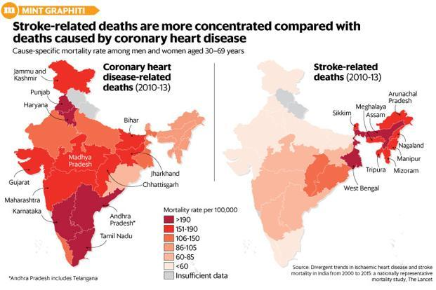

Slide 4


ADAM

Slide 5

Ailment detection and medical suggestion app
The app provides the user with valuable suggestions or remedies by specialized doctors along with their details.
Functions:
Barcode scanner
Smart selection
Emergency call

Slide 6
ADAM has three main characteristics:
Desired results obtained in a few steps.
User-friendly
This app offers relevant services.
Provides content instantly.

Slide 7
Design And Features

Slide 8


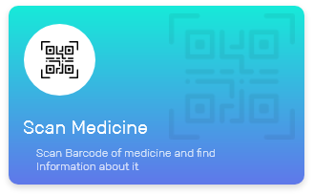
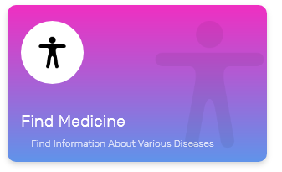
Home Screen

Slide 9





Emergency Call

Slide 10




Health Tips

Slide 11
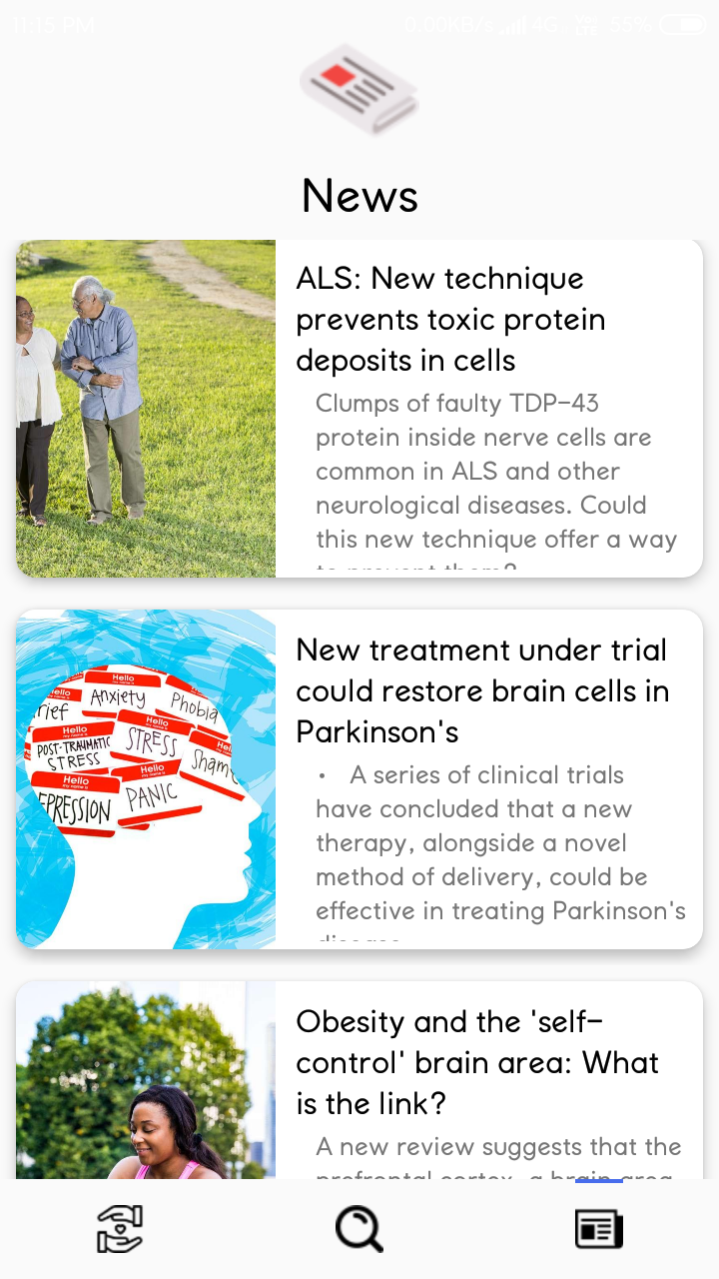
News

Slide 12
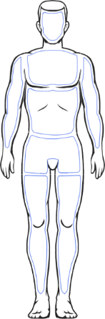
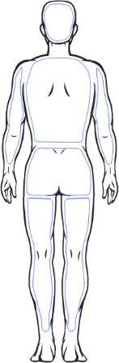
Smart Selection

Slide 13


Slide 14
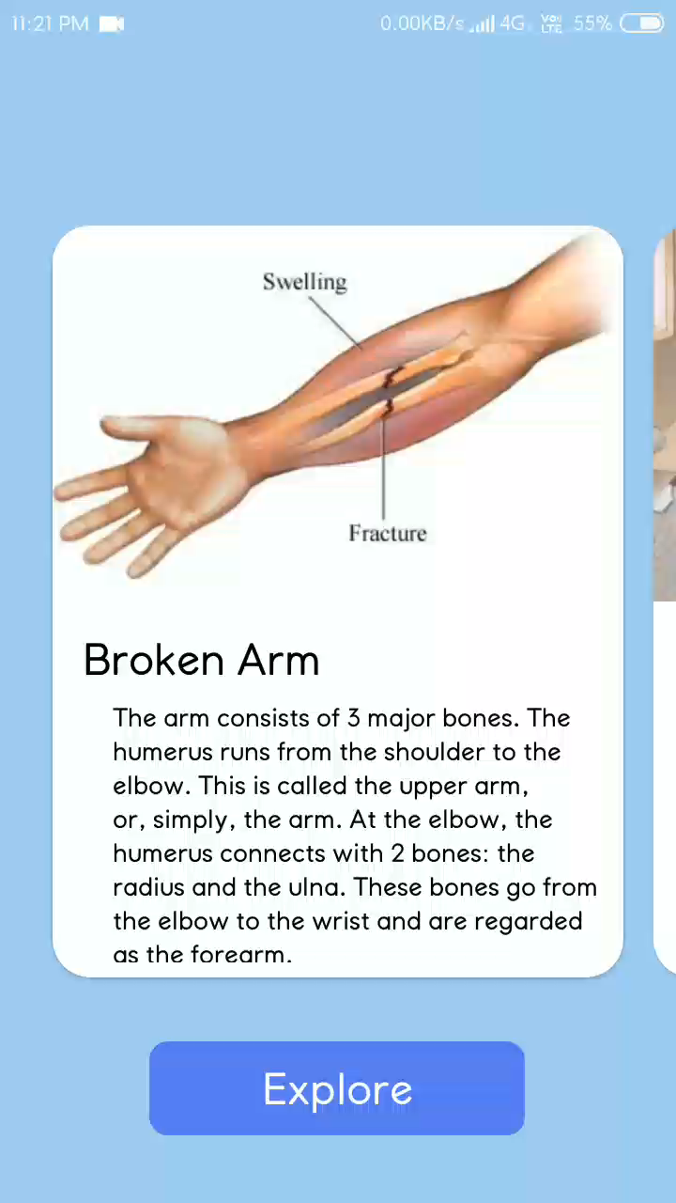
Swipe View
Gives you interactive selections
Provides various options
Easy to Find
Extends to Several Symptoms

Slide 15
Diseases Information
Gives you interactive selections
Provides various options
Easy to Find
Extends to Several Symptoms
Offers you Suggestions from Skilled Doctors

Slide 16
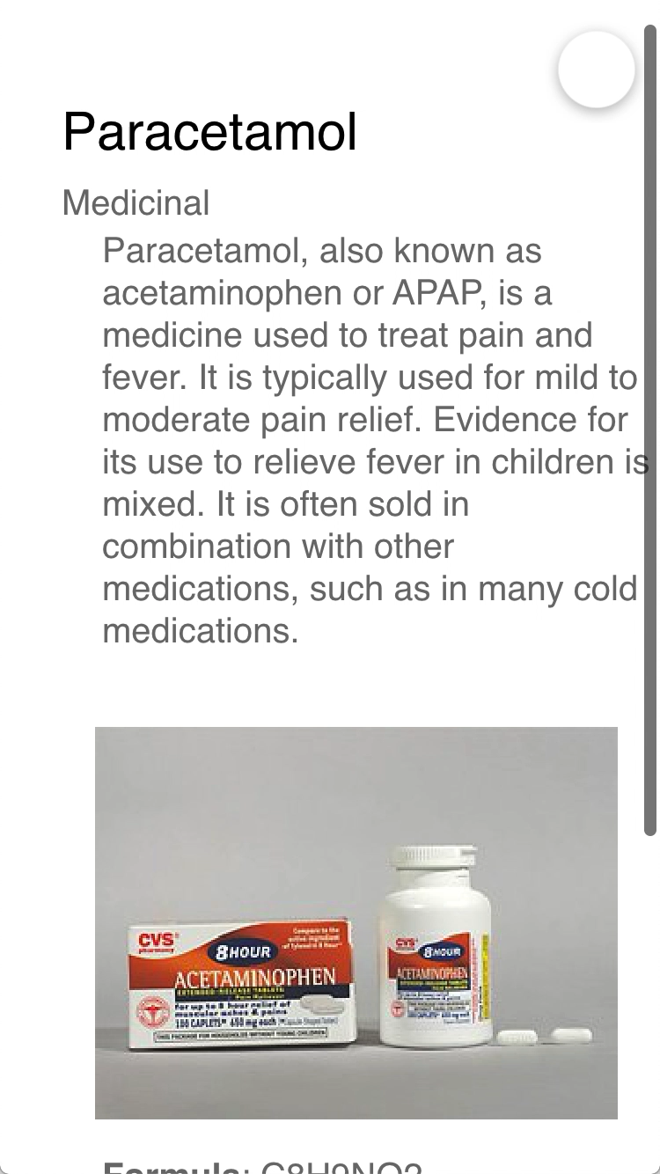
Medicine Information
Gives you brief information about the medicine
Provides Alternative Medicines
Self-Care Treatments
Medication Procedures
Extends to Several Symptoms

Slide 17
Tools and languages used for developing the Application
Android Studio
Java
Adobe XD

Slide 18
Proposed system
Accepting the symptoms from the user, creation of database of the user.
Speculating the disease based on the symptoms and provide the relatable diagnosis.
Provides users with the suggestion from the doctors specialized on the particular disease, even give contacts to approach them.
It has the potential to help hundreds of people every day to live a healthier life.

Slide 19
Hardware and Software Requirements:
Minimum Software Requirements:
Android Operating System Lolipop(5.0.0)
Minimum Hardware Requirements:
Camera ( 2 Megapixel)
RAM ( 1.5 GB)
Storage ( 8 GB)
Display

Slide 20
Area of applications
Medical
Home Remedies

Slide 21


It Did Not Required Data Connection

